Slide 1

SAKSHAM
Child Welfare and Educational Trust

Slide 2
About Us
An NGO, founded in 2016 at Alandi, Pune.
We give an opportunity to serve the society, to those who aren’t as privileged as us.
We are trying to cultivate the knowledge, skills, and mindsets necessary to build a larger movement for equity in education.
Our working style follow 4:1 student to teacher ratio. All rights and decisions regarding the respective kids are being taken by respective volunteers only.
Volunteers follow three major actions of keeping patience, tolerance and calmness.

Slide 3

VISION
MISSION
We believe that our efforts will lead children to attain excellent quality education they deserve.
To build a team of reagents to eliminate educational inequality between unprivileged.
FOCUS AREAS
To provide quality education to underprivileged children.

Slide 4
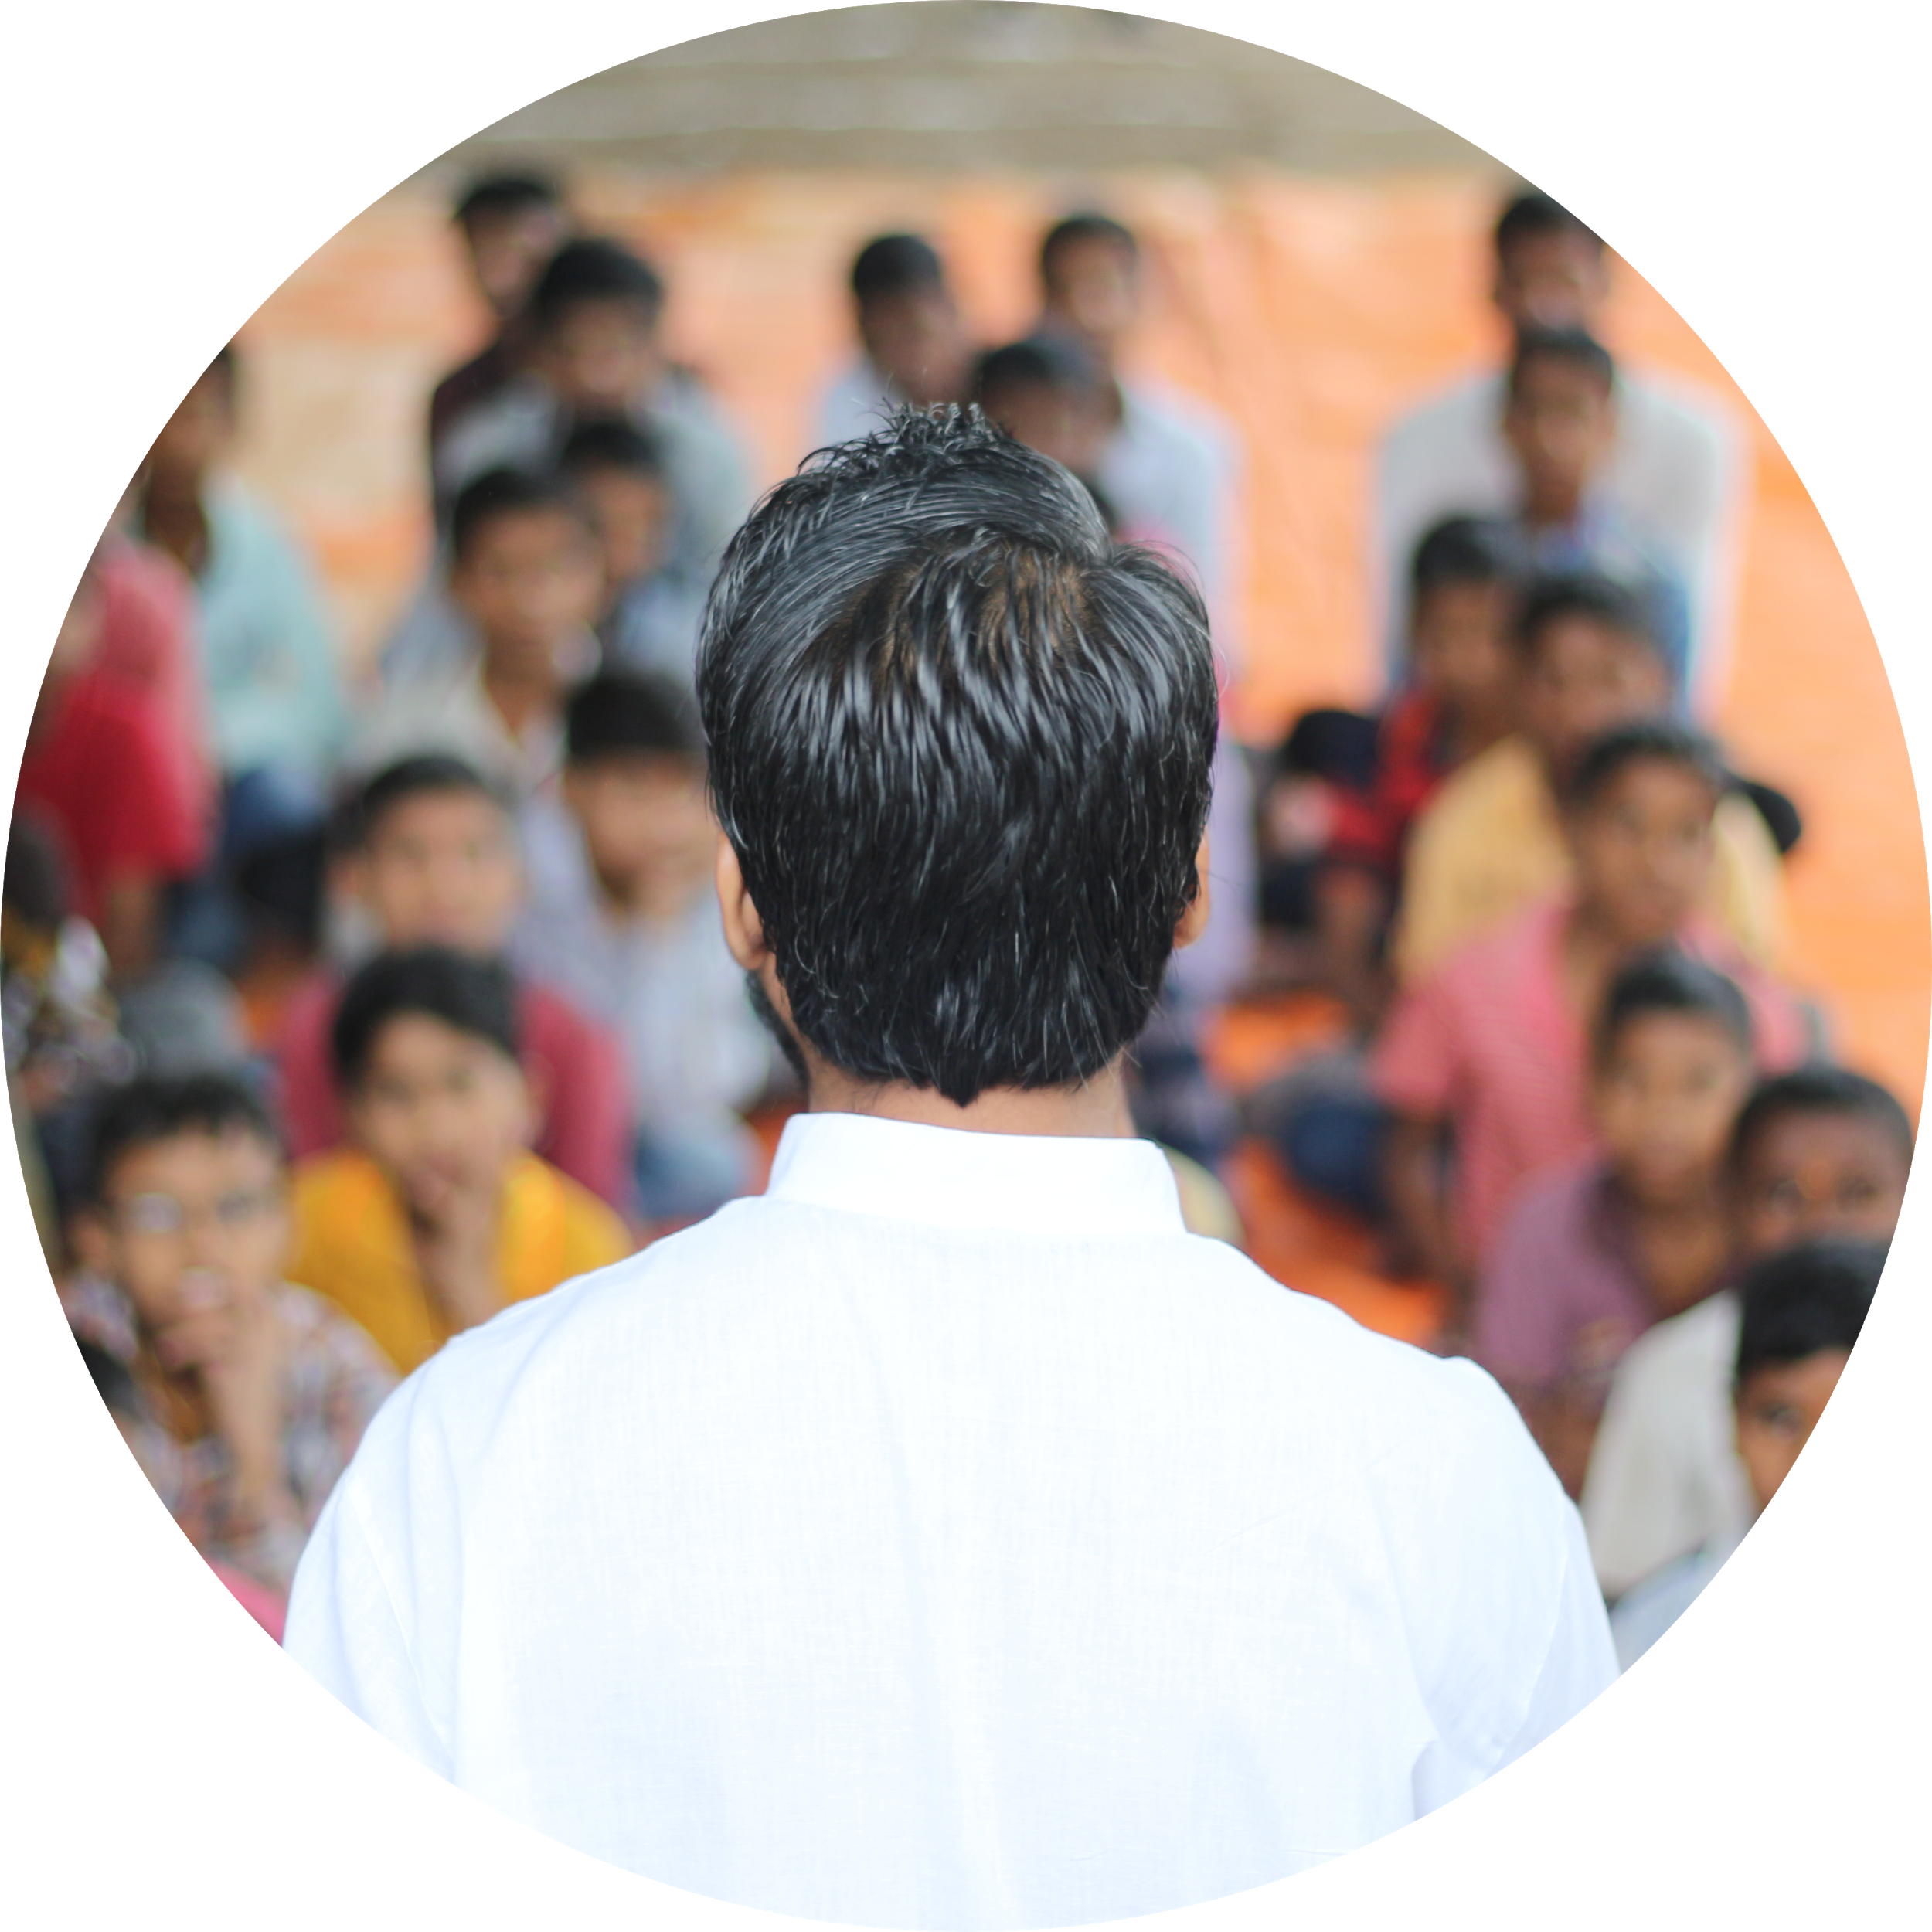
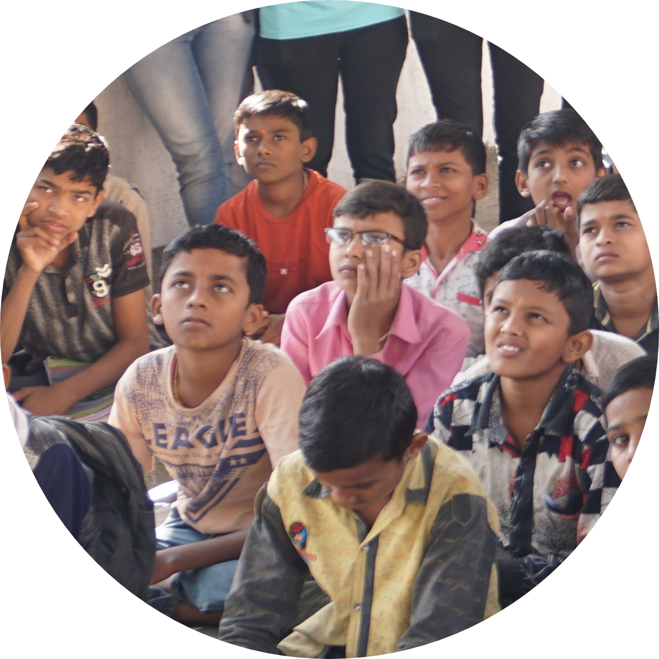
OUR STORY
In 2016, while being an Engineering UG student, Amitkumar and four of his friends i.e Manthan, Aishwarya, Kamini and Prashik felt that it is important to address the issue of privileged and underprivileged educational difference at scale.
As he thought through the solution, he believed that the answer lay in a people’s movement that needed to come together to provide every child in India an excellent education.

Slide 5
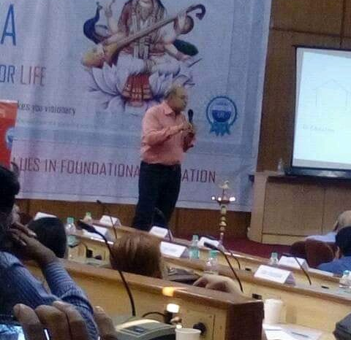
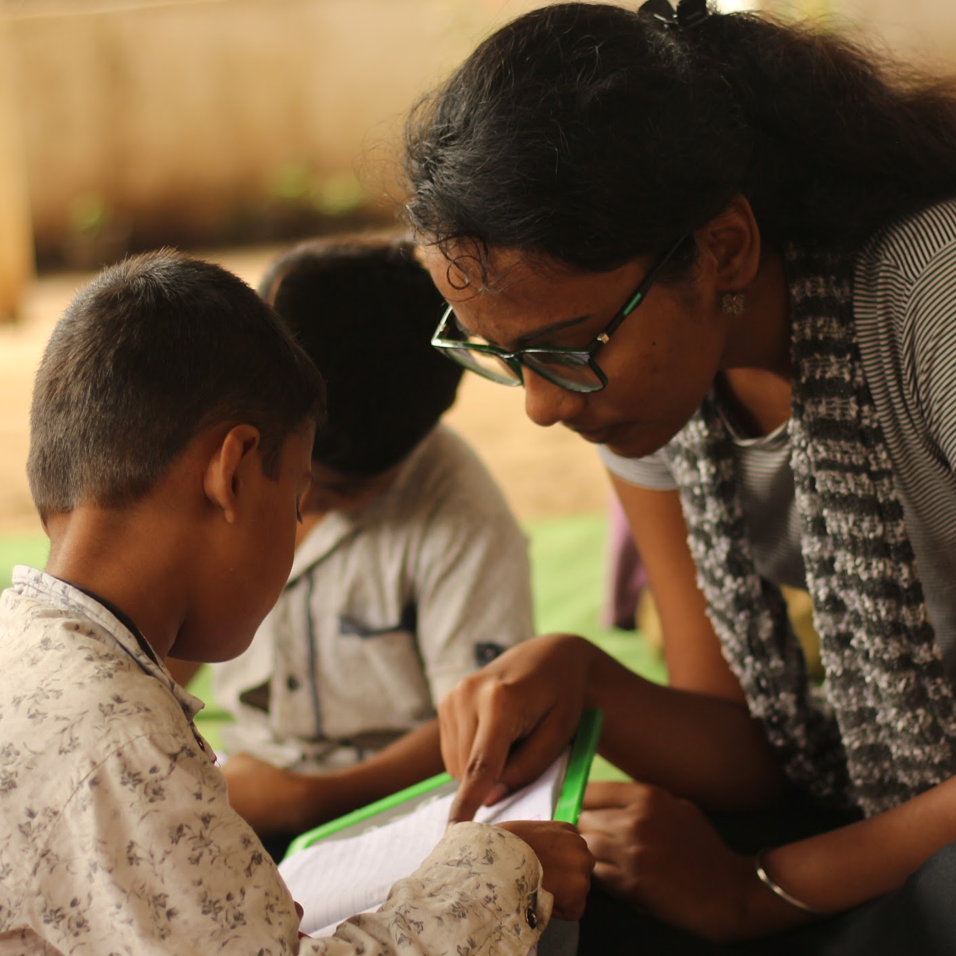
OUR STORY
In 2016, Amitkumar met with Dr. H.C Verma, the Author of Concept Of Physics and HOD of Physics department at IIT Kanpur. Their discussion came to a conclusion that we need to rectify the education methodology of Indian Education System.
In same year 2016, while interacting with the slums children, he and his team came to know that there are hundreds of such children in their vicinity only and they decided to do something for them. They started teaching them at their flat.

Slide 6
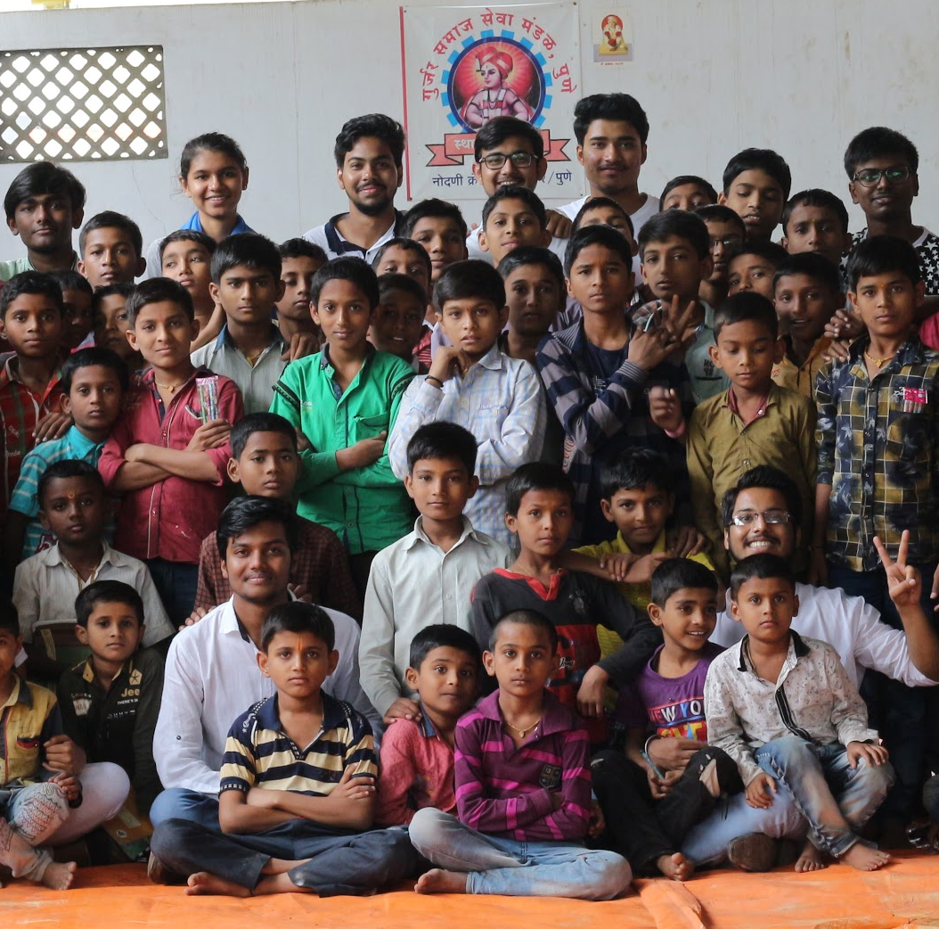
OUR STORY
The kids showed great enthusiasm and improvement and some more kids joined them, they were from local government schools but the condition of both the types of students were same. So they decided to teach them too.
Their hard work paid off and over years they have impacted lives of more than 300 children.Now they are a team of 80 people at Alandi, the base of their team, 90 people at ShivajiNagar, 65 at Amravati and still growing.

Slide 7

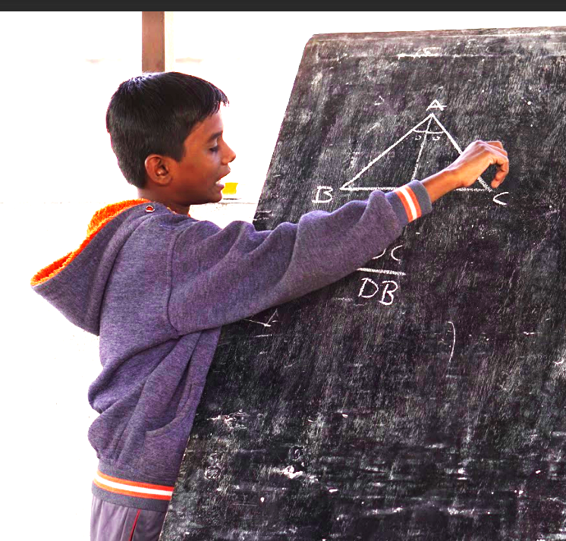
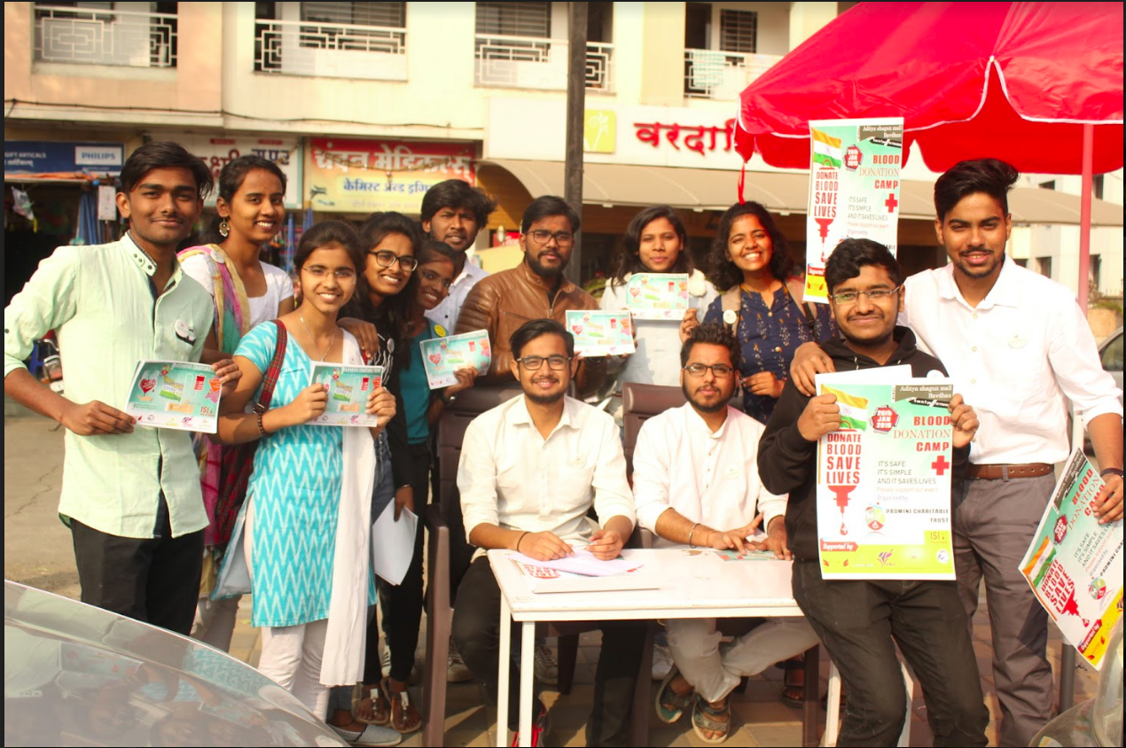
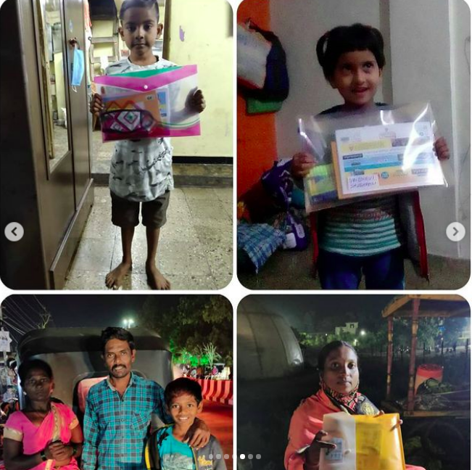
What Do We Do?
EDUCATE
VOLUNTEER
EMPOWER
We seek to educate every child out there in need
In various events that fuels and supports our mission
The people we work for and with!

Slide 8
Initiatives so Far ..
Evening Initiative
Independence Day
An initiative started for SSC students belonging to slums and government schools where our volunteers daily use to spend 2 hours with them to solve their queries.
Arranged some cultural activities, told them about the importance of the day, involved them in various activities like songs, dances and monologue, to identify the hidden talent of them.
Blood Donation Camp
Distribution Drive
Distribution of basic required study material to the students.
Blood Donation Camp has been organised to make them aware about importance of Blood Donation
2018

Slide 9
Initiatives so Far ..
Internship for volunteers
Health Check Up
A medical free health checkup camp has been arranged for those kids to diagnose them and to generate a health report for them.
Considering efforts of volunteers for the society, we decided to take care of their careers, we find and make sure that all our volunteers should get internships w.r.t their fields.
Manners and Ethics Workshop
Placement Assistance
Volunteers conducted workshop for kids to make their personality, a well developed one with respect to manners, ethics and etiquettes.
To take care of their careers, we arranged a free placement assistance from our alumni for the volunteers.
2018

Slide 10
Initiatives so Far ..
Psychological analysis of students
Colors Viacom Talent Hunt
We organised a special session with one of the certified human psychologist to analyse the students psychologically and sentimentally.
Our talented Kids got featured in a short video by Colors Viacom Talent Hunt
showcasing unique talent of our kids and they also praised our
initiative.
2018

Slide 11
Initiatives so Far ..
Antyoday-Children’s Marathon
Vatsalya
Marathon was being organised for them where we distributed them t-shirts, trackpant, caps free of cost and also arranged a carnival for them where volunteers arranged games for them, tatoo making stall for them
Considering efforts of volunteers for the society, we decided to take care of their careers, we find and make sure that all our volunteers should get internships w.r.t their fields.
Menstrual Hygiene Camp
Placement Assistance
A Menstrual hygiene
camp was organized which taught the
children the importance
of menstrual hygiene.
To take care of their careers, we arranged a free placement assistance from our alumni for the volunteers.
2019

Slide 12
Initiatives so Far ..
Nation Wide
Initiative
Solar Eclipse
A nation wide initiative
was started by us and
thus our family grew
with more volunteers
joining from Ajmer,
Noida, Delhi NCR, Jaipur
and Chennai.
#connecttoeducate
The Astronomy Club at COEP arranged
everything for our kids.
They explained how
eclipses occur and why
you need some special
goggles to see them.
2019

Slide 13
Initiatives so Far ..
Republic Day
Celebration
Learning Bits By
Saksham
Our volunteers prepared the children of Alandi Ashram for performances based on the cultures of different states of India and understand the diversity of our nation. There were folk dances, songs and acts through which the whole nation was put in front of the crowd.
The very first online initiative of Saksham in which our volunteers are enthusiastically making videos to explain some concepts of Science and Mathematics and also on some important topics, which are then shared on our instagram page.
Syllabus and Worksheets Design
Vaatsalya
During lockdown, we couldn't resume the campaign, we invested our time in designing the syllabus as per the need and level of the kids whom we teach. We also designed very creative worksheets to clarify the concepts of the kids effectively.
On the occasion of Children's Day, our volunteers donated a basic educational kit to the financially challenged kids in their locality, shared love and showed care for the children.
2020

Slide 14
Milestones Achieved
70.68 %
6
10th result
Internships
269
Team Expansion
Own Syllabus Designed

Slide 16

Noida
Ajmer
Ghaziabad
Alandi
Amravati
Pune

Slide 17

Noida
Ajmer
Ghaziabad
Alandi
Amravati
Pune

Slide 18
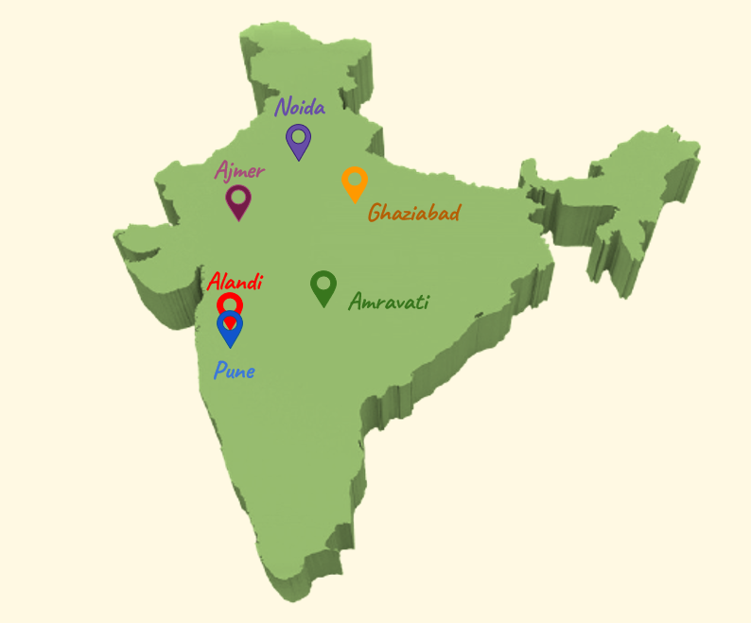

Slide 19

So far we have
260
269
6
Kids been given Education
Volunteers, to join hands in this mission
Locations across the nation

Slide 20
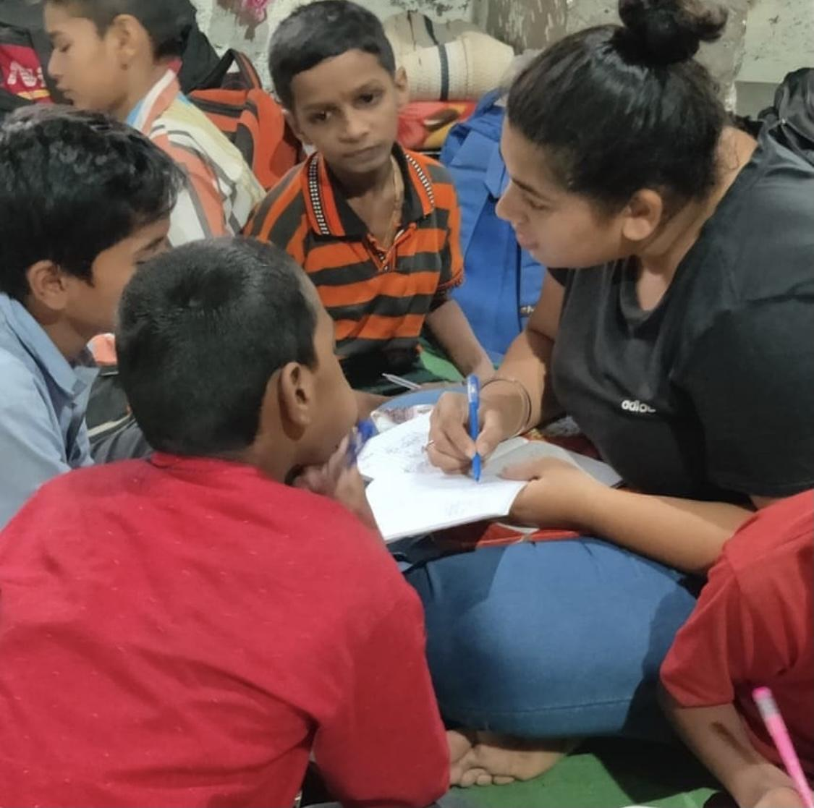
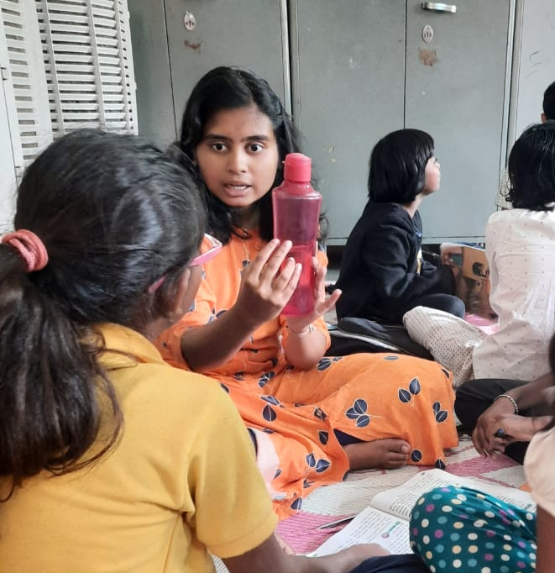
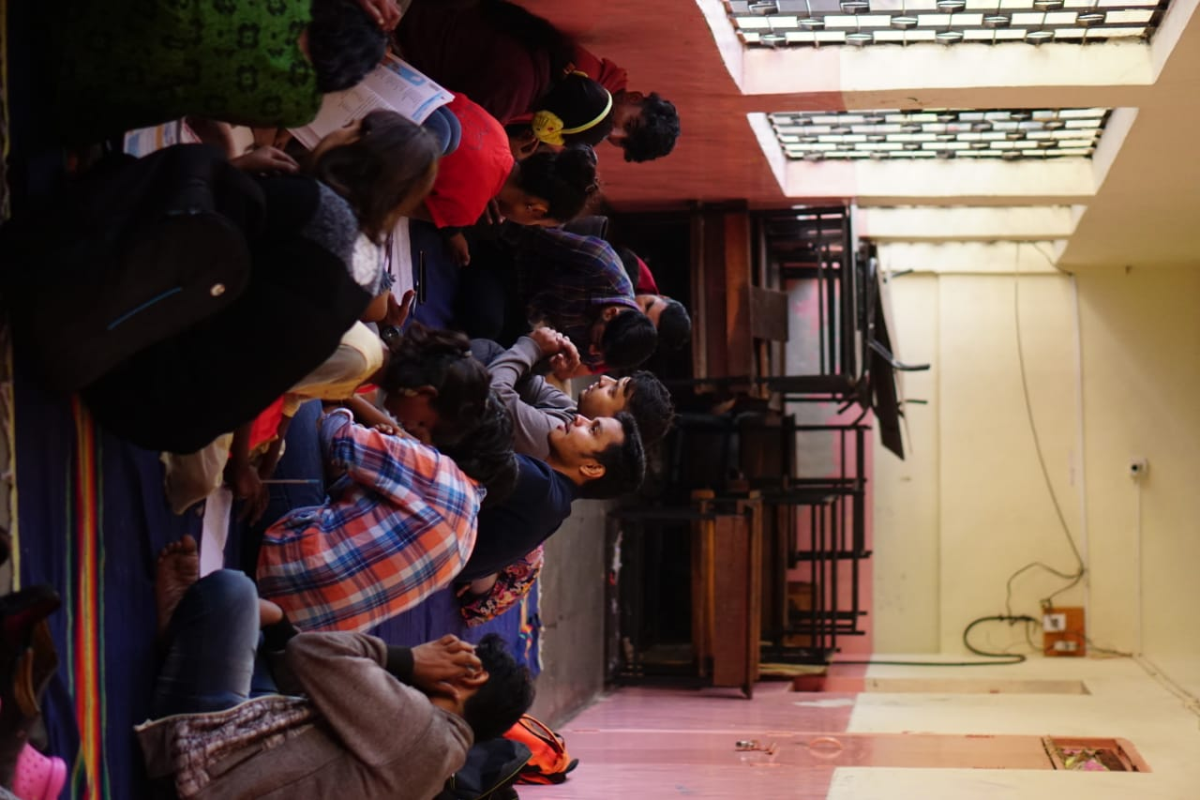
What Do They Say About Us?
Tanmaee Rakvi
Shalaka Bhosale
Saksham has provided me with a platform to give back to society. One of my favourite things at Saksham is the Sunday Campaigns! Teaching the children on Sunday morning and seeing the smiles on their faces makes my week.
SAKSHAM I think cannot be described in words. All I can say in this dark world SAKSHAM is it's bright side. All these efforts though they are small will surely make a difference in many lives and a better place to live
Shubham Karne
Joining Saksham was probably one of the most important decisions of my life. After Saksham it's safe to say that my life has changed for good. Spending time with the kids has shown me the hidden side my own self. Their ability to enjoy life despite the adversities has taught so much about life. I am forever grateful for this.

Slide 21
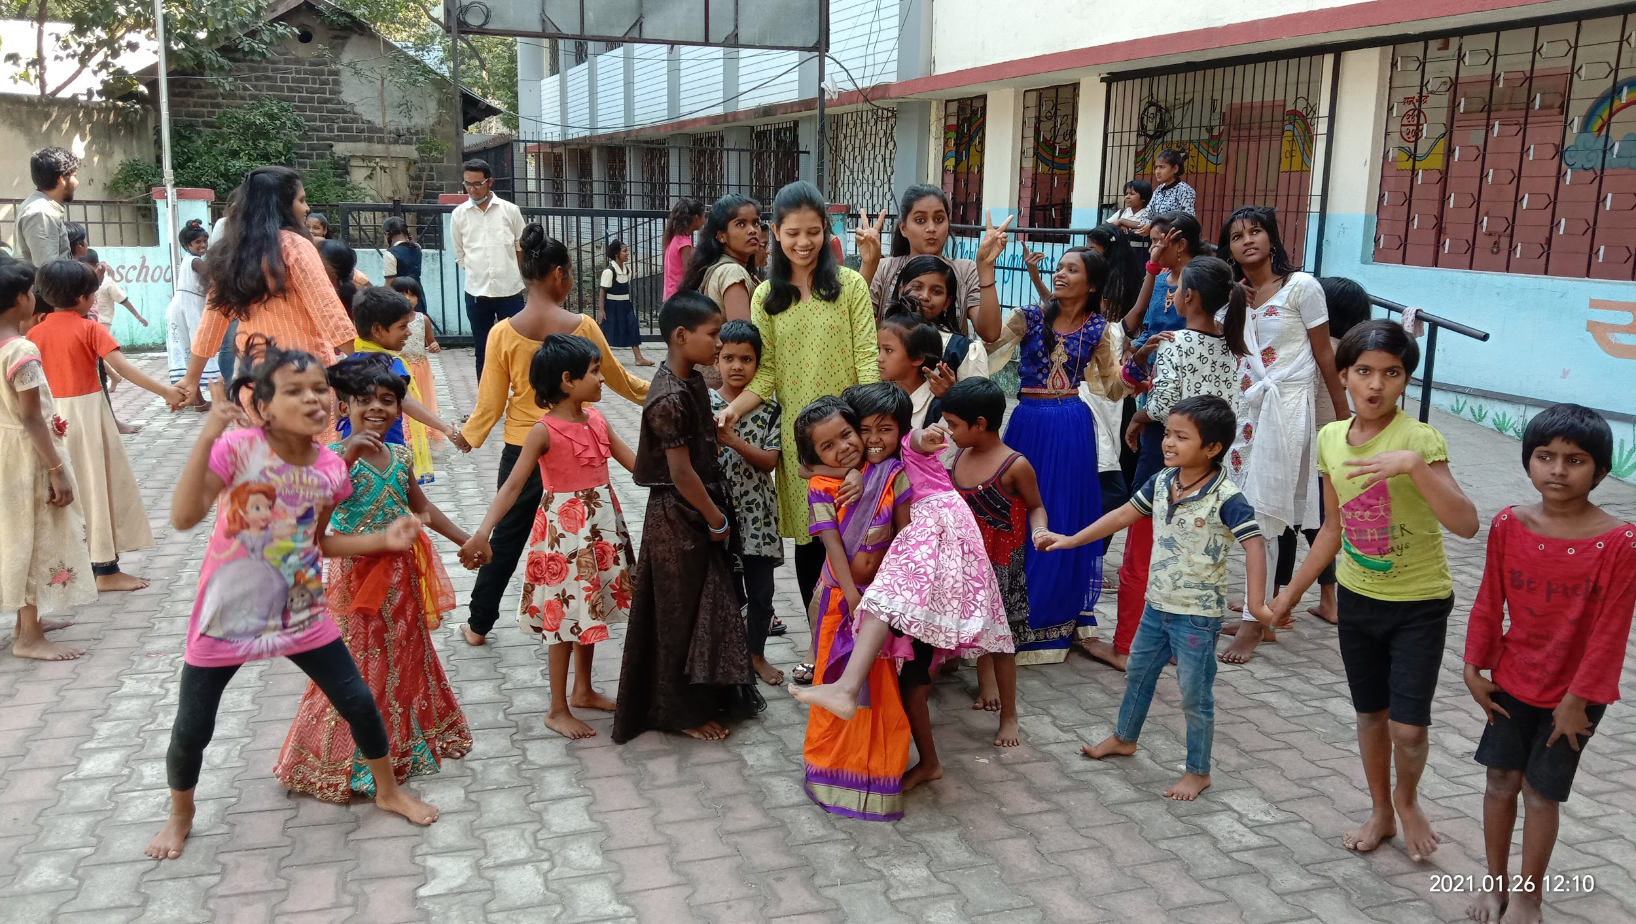
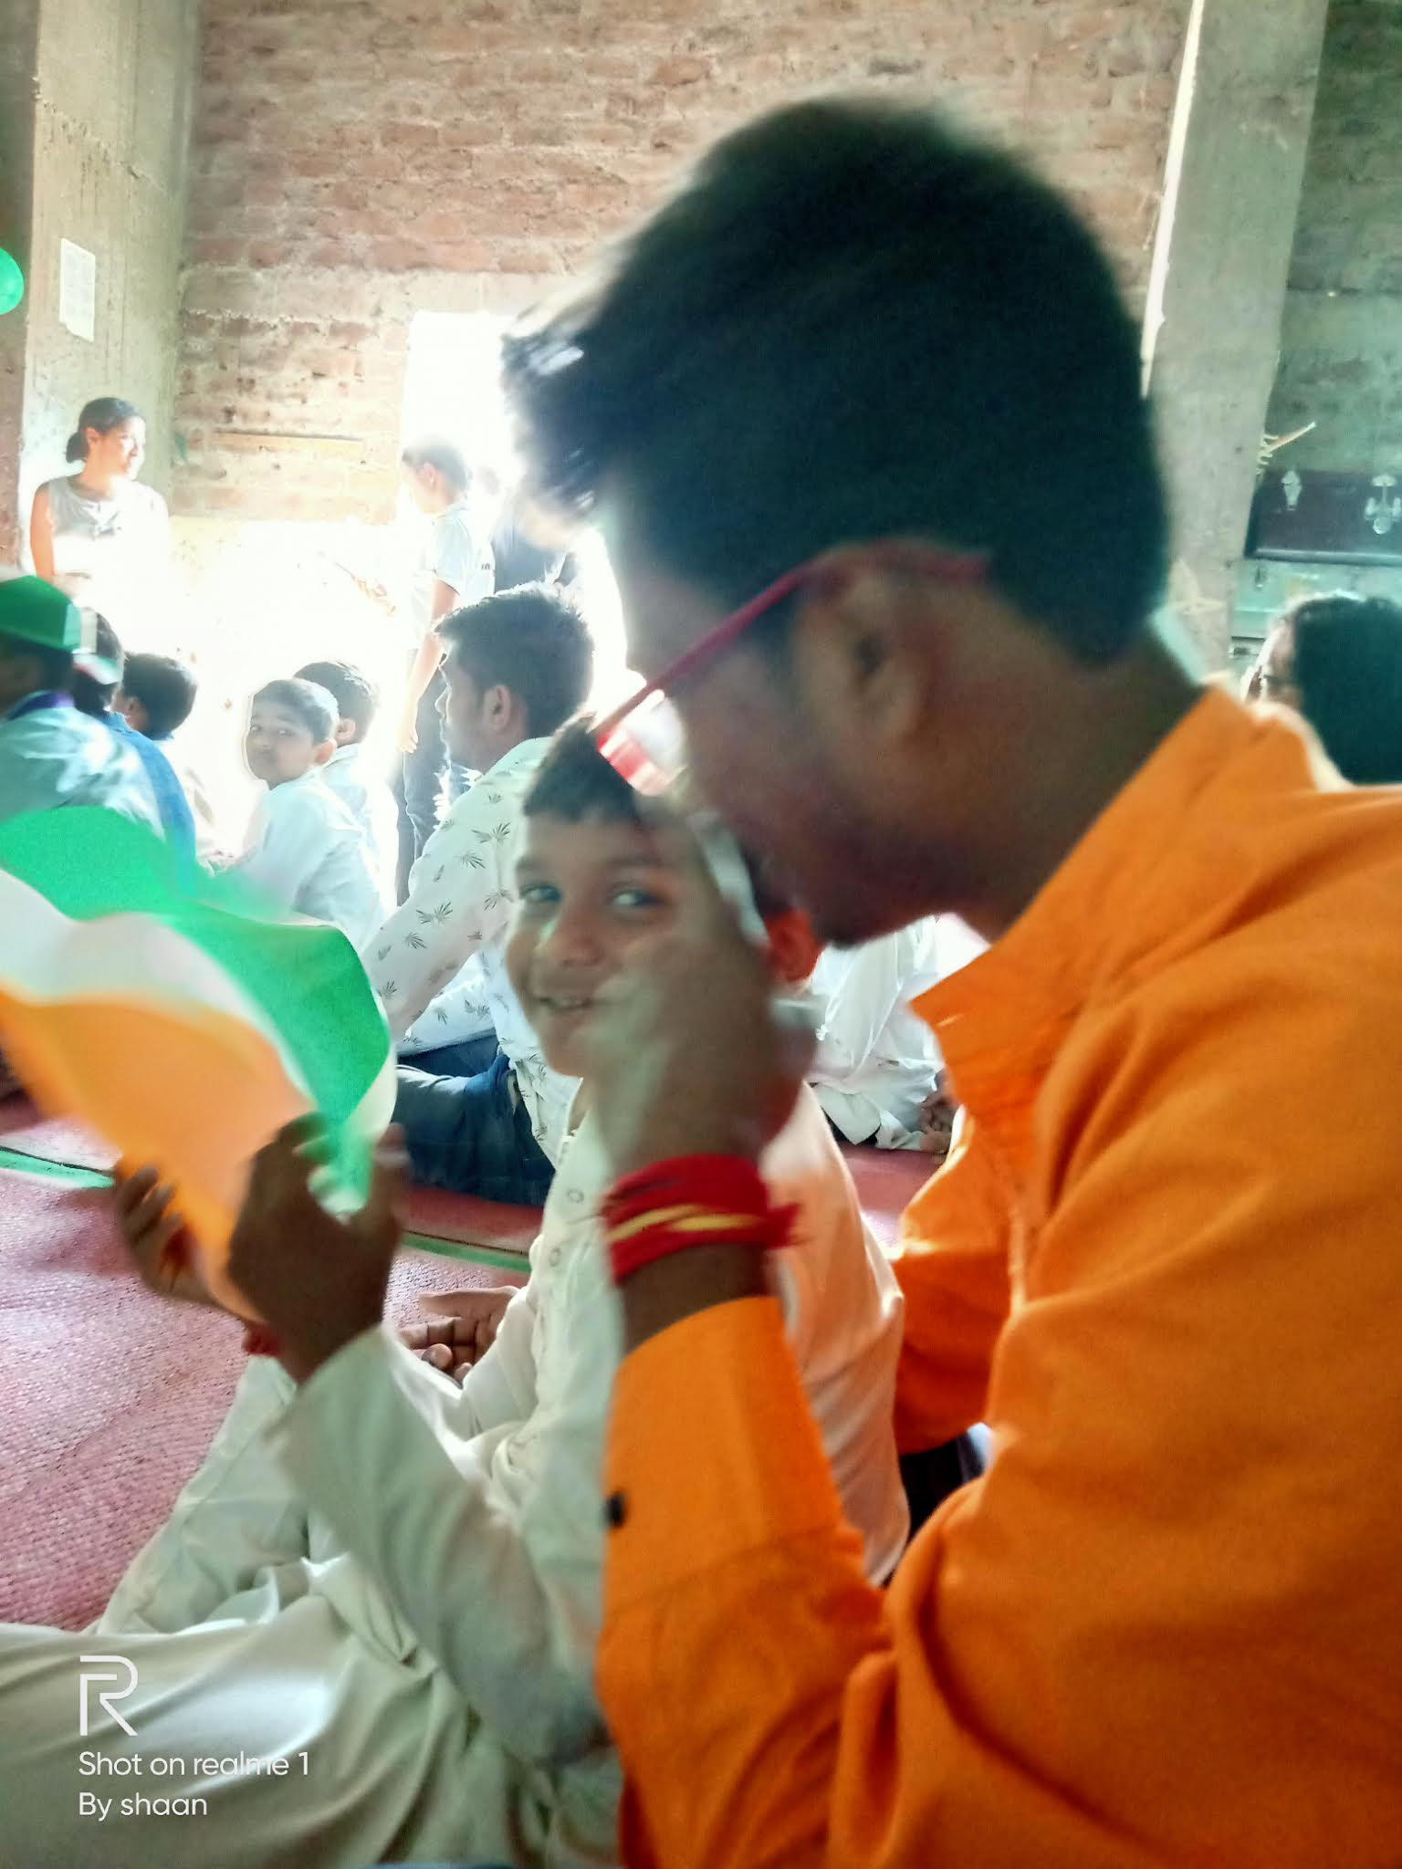
What Do They Say About Us?
Krutika Kadam
Shantanu Pabitwar
I have joined Saksham in Lockdown. Up till now I have attended 3 campaigns in this year. And it was a great experience for me. I have got new family. The time that I'm sparring with those children is amazing. I haven't got this experience before.I'm really very happy that I'm part of this beautiful family. Whenever I'm seeing the smiles on those innocent faces I'm getting new hope. It's a great initiative took by Saksham and I wants to be part of this lifelong.
It has been a year since I have joined SAKSHAM In that one year I came to learn so many things.. Questions of the kids gave me a different perspective to think about a previously known topic. Overall my experience was too good. I also got an opportunity to interact with seniors which are always ready to answer any queries and help.

Slide 22
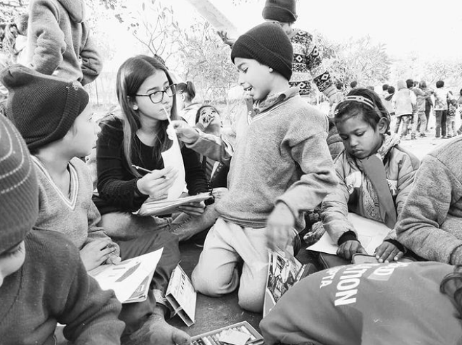
Future
Goal
Saksham’s presence all over Maharashtra!

Slide 23

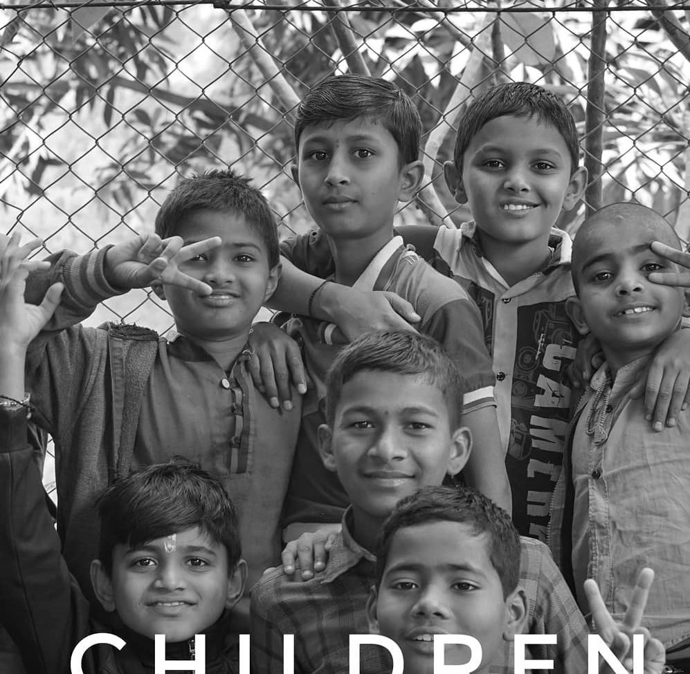
Thank You !
Do you have any questions?
sakshamedu71@gmail.com
8007850690
@Sakshamedu71
@saksham_edu
@saksham

